Slide 1
Workflows and pipelines
What is a workflow
Why use a workflow
Caution about using a workflow
Examples
Shell
Snakemake
Nextflow
… more …

Slide 2
workflow/ pipeline
What is the difference between a workflow and a pipeline?
In short I don’t know. They seem to be used interchangeably by the community if you look around the net.
.. This is only an overview to introduce you to it. It will take lots of practise to get good at it.

Slide 3
What is a workflow/ pipeline
Hopefully from the name you can deduce, it is a flow/ series of “things” (for us, commands) that achieve “something” (a desired output)
.. a very loose and simple definition:
A workflow is a series/combination of commands combined into one script to return a final outcome
For example, a single script to: trim the reads, QC the reads, quantify the transcript abundance using the reads against a reference.
(trimmomatic, FactQC, Salmon) <- in one script.

Slide 4
Why use a workflow/ pipeline
Reproducibility! – you can share and reused.
A record of how the analysis was done (very useful)
Workflows can be made to be flexible so they can be used to analyse similar datatypes. Thus removing repetitive and potentially error prone human input.
They can be made to interrogate the data to reduce the chance of run time errors .. See next slide
They can be made to explicitly use certain version of software.

Slide 5
Caution about using a workflow/ pipeline
If it is not well coded and tested, the user may end up hacking/ patching the scripts until they get “an answer” – this answer may not be what they think it is (the correct one??).
Software version change
Image from Iain and Micha

Slide 6
Caution about using a workflow/ pipeline
Oh and inputs do often do weird things!
Do you really know what it is doing?
It is flexible enough for your data/ question?
Image from Iain and Micha

Slide 7
Example of what a workflow could be …
If you ran all these commands required to complete each step = a long time, a lot of waiting.
(human) Error prone
Image from Iain and Micha

Slide 8
Shell scripting (bash)
The first pipeline method:
Shell scripting is the easiest method for generating a workflow. If you are new, start here.
Act as a way for the human to tell the computer what to do.
Shell script filenames end in .sh and may have
#!/bin/bash on the first line (this is the program to execute the file).

Slide 9
3) Basic UNIX: Some “gotchas” (character changes)
Line endings: Linux uses /n (newline) windows uses /r/n (carriage return newline).
Programs will fail is they come across this - they don’t know what to do with it.
Either change the file with :
dos2unix Filename
Or in Notepad++: Edit > EOL > UNIX
Change of characters in Microsoft Office products.
Ll –l (capital when it is not supposed to be)
ll -l ( - gets changed to a big dash)

Slide 10
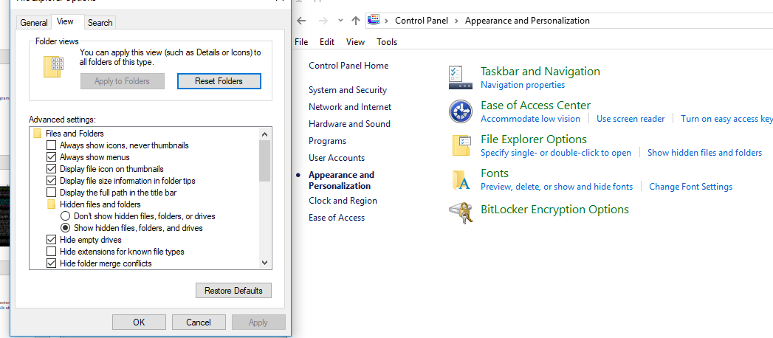
3) Basic UNIX: Some “gotchas”: Windows disable hide extensions.
This is a useless feature and sooner or later will be the cause of something not working. CHANGE IT!! (control panel > appearance …)

Slide 11
3) Basic UNIX: Spaces in filenames
Linux doesn’t like spaces in filenames.
Linux sees spaces in commands as another command.
You have the wrapped quotes around the filename if you want spaces...
Easier just to get in the habit of not using spaces.

Slide 12
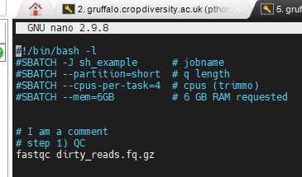
Shell scripting (bash) - intro
The -l option makes "bash act as if it had been invoked as a login shell". Login shells read certain initialization files from your home directory, such as . bash_profile
(I have had to do this on another SLURM system).

Slide 13
Shell scripting (bash) - intro
SLURM commands:
#SBATCH instead of typing them at the command line
Alternatively you can add the SLURM commands at the command line during sbatch

Slide 14
Shell scripting (bash) - intro
First actual command is to run a program called: fastqc …

Slide 15
Shell scripting (bash) - intro
(show the example): /mnt/shared/scratch/$USER/private/shell_examples/
First make the shell executable: chmod u+x name_of_shell.sh
Submit: sbatch name_of_shell.sh
Complex example: complex_example.sh (details on next slide)

Slide 16
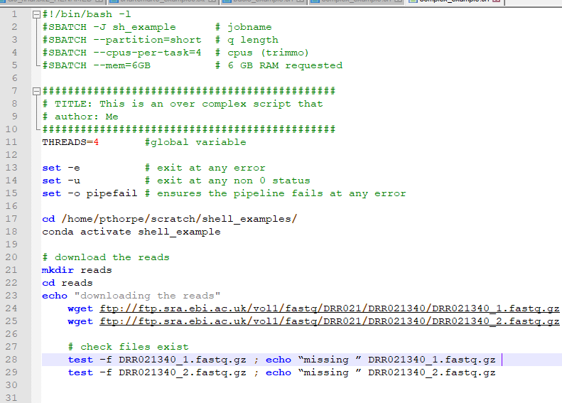
Shell scripting (bash) – more advanced
Slurm stuff
Break the pipeline, if fails
Make folders, download reads
Test they are there

Slide 17
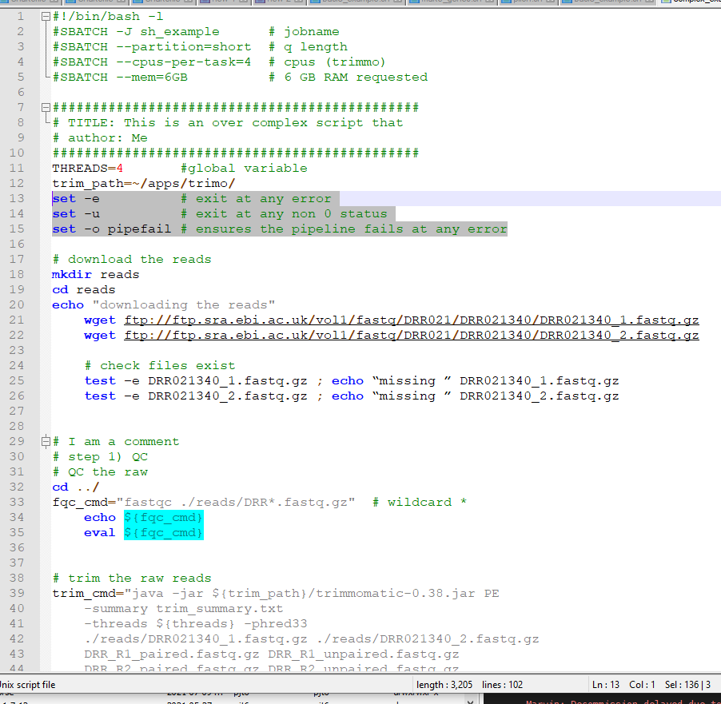
Shell scripting (bash) – more advanced
Slurm stuff
Break the pipeline, if fails
Make folders, download reads
Test they are there
QC
Trim

Slide 18
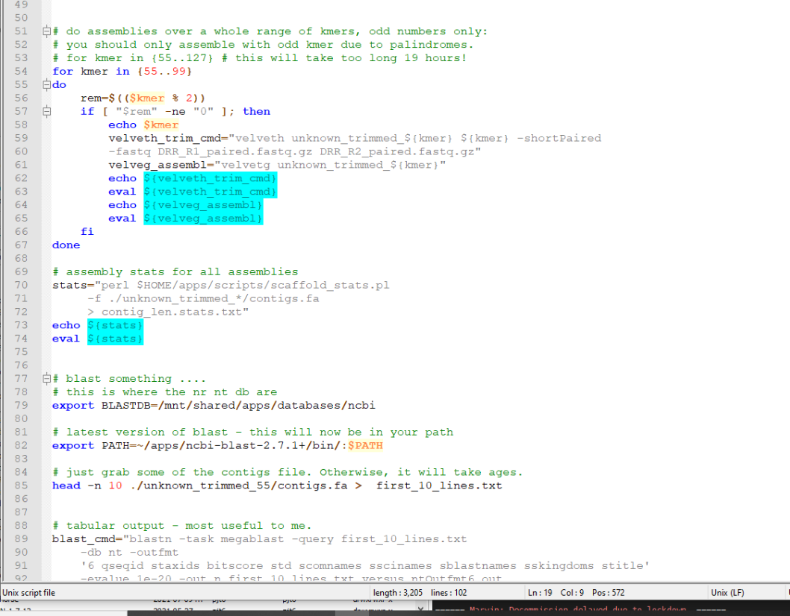
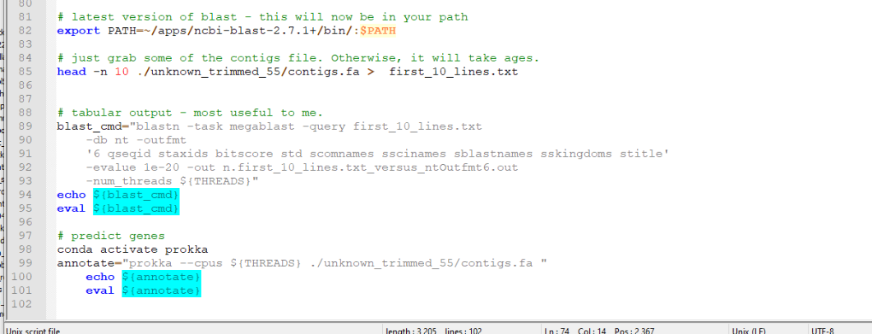
Shell scripting (bash) – more advanced
… and then…. Assemble at every odd kmer
Stats for the assemblies
Export db and apps
Blast
Predict genes

Slide 19
Shell scripting (bash) – some thoughts
Anyone who knows bioinformatics knows that tools/ scripts fail due to the gravitational flux of the moon, and how loud the wolves howl. (choose your real answer)
Things fails… a lot.
So what re run-the whole lot? Alter the code to test if steps have already succeeded?
Maybe.. Up to you.. There are alternatives for when the scripts get complex. Probably a better option!!

Slide 20
Shell scripting (bash) – command line arguments, to make it more flexible.
Name_of_shell.sh option1 option2 option3
In the shell script $1 $2 $3
Fastqc $1 within the shell script, for example could be at the command line:
fastqc R1.fq.gz

Slide 21
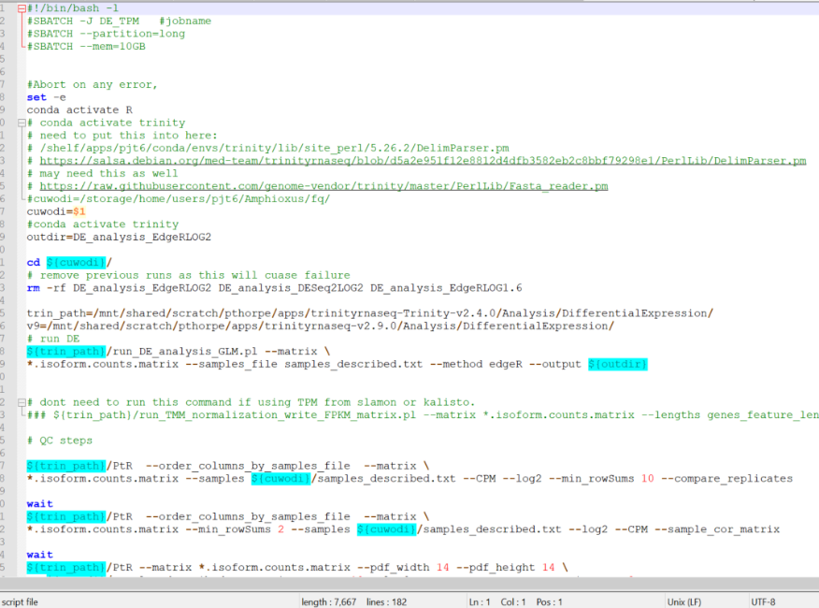
Shell scripting (bash) – command line arguments, EXAMPLE
I have a “pipeline” for pairwise differential expression analysis. I do this a lot.
sbatch DE_analysis.sh path_to_data <- this is my $1
If the files are there
It will run

Slide 22
Shell scripting (bash) – some thoughts
Getting the more complicated shell script to run on this cluster took quite a few “hacking sessions”
It worked fine on another cluster ☺

Slide 23
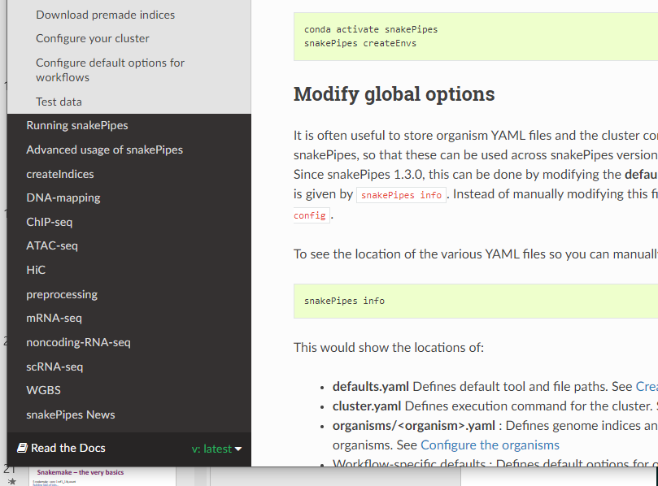
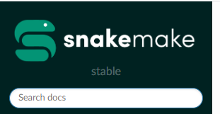
snakemake (steeper learning curve)
Based in python, thus line indentation.
The docs: https://snakemake.readthedocs.io/en/stable/
https://carpentries-incubator.github.io/snakemake-novice-bioinformatics/
Many workflows are public … https://snakepipes.readthedocs.io/en/latest/content/setting_up.html

Slide 24
Snakemake – the very basics (install)
Snakemake (install via conda)
# create a conda env for snakemake
conda create -n snakemake snakemake
# using mamba (conda install -c conda-forge mamba)
mamba create -c conda-forge -c bioconda -n snakemake snakemake
conda activate snakemake

Slide 25
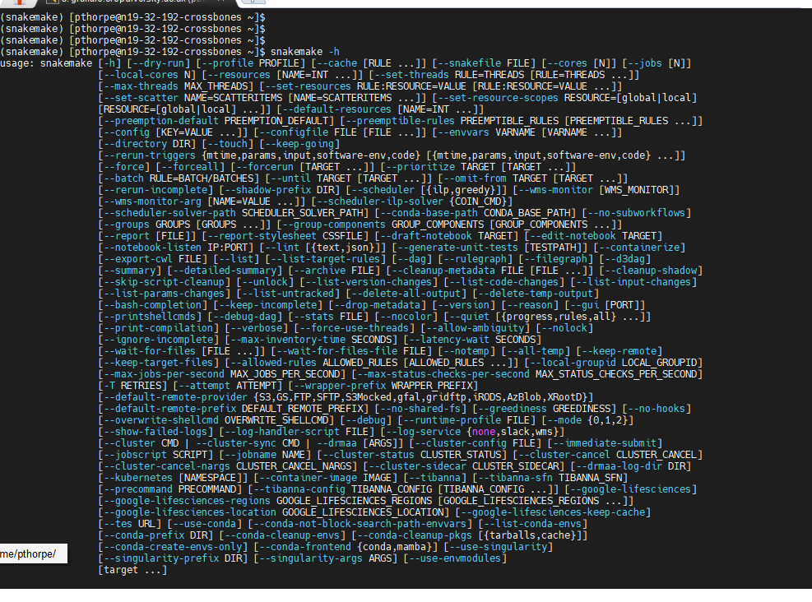
Snakemake – the very basics (install)
Snakemake –h (lots of options!!)

Slide 26
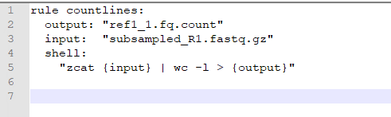
Snakemake – the very basics
Snakemake (install via conda) looks for a Snakefile. The snakefile is where you “give it instructions”. These instructions are called rules.
This example in the Snakefile contains a rule “countlines”, will count lines in a file
If we run this .. Next slide.
(note this is not flexible, but a hard coded example) (Run the example)

Slide 27
Snakemake – the very basics
$ snakemake --core 1 ref1_1.fq.count (you ask for the desired output, in this case a file)
Building DAG of jobs...
Using shell: /usr/bin/bash
Provided cores: 1 (use --cores to define parallelism)
Rules claiming more threads will be scaled down.
Job stats:
job count min threads max threads
---------- ------- ------------- -------------
countlines 1 1 1
total 1 1 1
Select jobs to execute...
[Thu Aug 11 11:41:42 2022]
rule countlines:
input: subsampled_R1.fastq.gz
output: ref1_1.fq.count
jobid: 0
reason: Missing output files: ref1_1.fq.count
resources: tmpdir=/tmp/pthorpe_3055749
[Thu Aug 11 11:41:44 2022]
Finished job 0.
1 of 1 steps (100%) done
Complete log: .snakemake/log/2022-08-11T114141.513610.snakemake.log
If we try and run it again it says “nothing to be done” as the output file exists… This is useful. (think about the failures!)

Slide 28
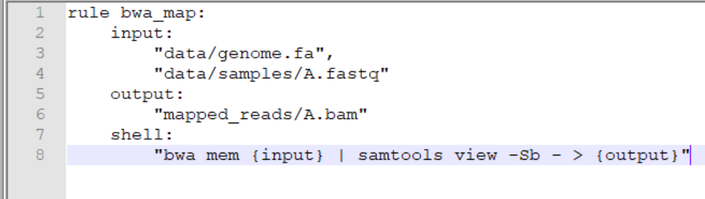
Snakemake – the very basics
This example bwa_map will map reads
Run this, by asking for the output file:
snakemake --cores 1 -p mapped_reads/A.bam
Note: -n if used, is a dry run and print the commands. Very useful as a sanity check.
-p print shell commands

Slide 29
Snakemake – the very basics
You will see all the magic is done by things in {MAGIC} brackets, called placeholders ….
The input and output filenames must match in some part {} as these become the wildcards. (example to come ..)
from the rules you will see, input, output, maybe some sort of wildcard.
{input} - The input file(s)
{output} - The output file(s)
{wildcards} - The wildcard

Slide 30
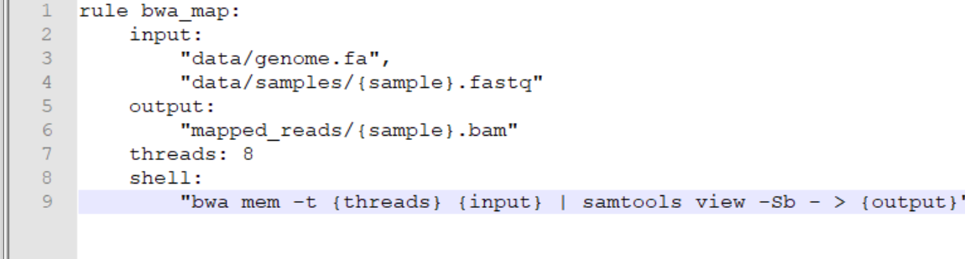
Snakemake – the very basics
The bwa_map rule was not flexible…. Lets make it flexible.
Note, the “matching part” I spoke about on the last slide {sample}.fastq and {sample}.bam. The sample match.

Slide 31
Snakemake – the very basics
The bwa_map rule was not flexible…. Lets make it flexible.
If you now ran this with (only need to ask for the output and it can work out what the input should be):
snakemake --cores 6 -p mapped_reads/A.bam
snakemake --cores 7 -p mapped_reads/B.bam
(It would work if this output files did not already exist. )
(Run the example)

Slide 32
Snakemake – the very basics
The bwa_map rule
To map many samples A.bam, B.bam, C, D, E etc ..
You could set up a sample list:
Samples = [“A”, “B”, “C”, “D”]
Use the expand function to create these output bams:
https://snakemake.readthedocs.io/en/stable/tutorial/basics.html#step-5-calling-genomic-variants
bams=expand("results/mapped/{sample}.bam", sample=samples)

Slide 33
Snakemake
Conda: You can integrate conda environments, and even change envs within a snakemake rule.
WARNING: it create a tmp conda env in your $HOME directory – not good!! Excess small files in backup!! – we will look into a fix for this.
https://snakemake.readthedocs.io/en/stable/snakefiles/deployment.html?highlight=conda#integrated-package-management
--use-conda (flag)
Singularity: it is possible to use singularity from within Snakemake (--use-singularity): https://snakemake.readthedocs.io/en/v5.8.1/_modules/snakemake/singularity.html

Slide 34
Snakemake and queue submission
Snakmake can control the submission of jobs to SLURM (or Sungrid if applicable). --cluster options
https://snakemake.readthedocs.io/en/stable/tutorial/additional_features.html
$ snakemake all --jobs 100 --cluster "sbatch --cpus-per-task=1 --parsable" --cluster-status ./status.py

Slide 35
Snakemake
You can “benchmark” to determine RAM usage at each step/ rule.
https://snakemake.readthedocs.io/en/stable/tutorial/additional_features.html
Testing is something which should be done, especially if the workflow is complicated. You can even auto generate unit tests. (but on a small subset of data!!)
https://snakemake.readthedocs.io/en/stable/snakefiles/testing.html

Slide 36
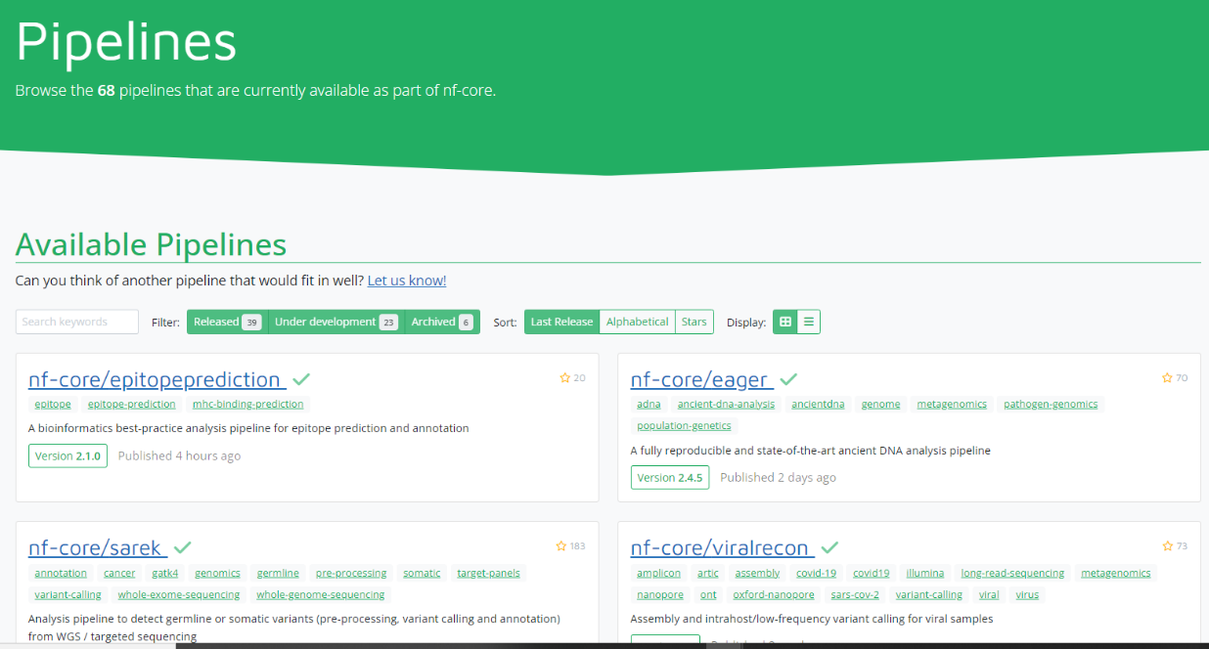
Nextflow
Based in Groovy not python: https://www.nextflow.io/
Good support for Docker, singularity and HPC environments.
https://nf-co.re/pipelines

Slide 37
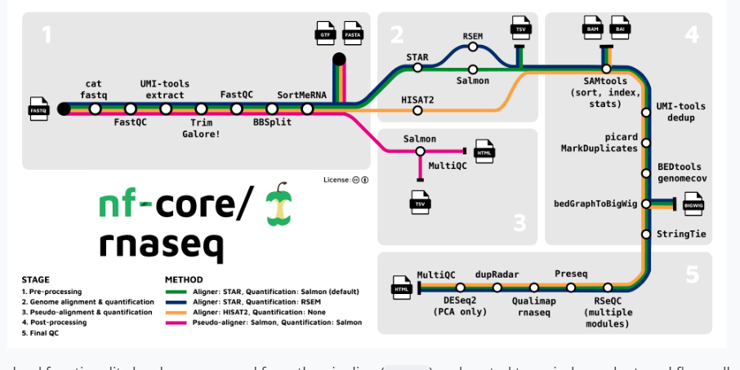
Nextflow
RNAseq example: https://nf-co.re/rnaseq
Look at this example below: AMAZING.

Slide 38
More
There are a lot of other options we did not discuss: Make, Jupyter notebook, Galaxy, any programming language, several commercial ones …
There are lots of options
Perhaps start with something people working around you use so you can get help. Then see where the work takes you.
Look at examples on github/ published resources.

Slide 39
Good luck.

